Slide 1
Website Mockups

Slide 2
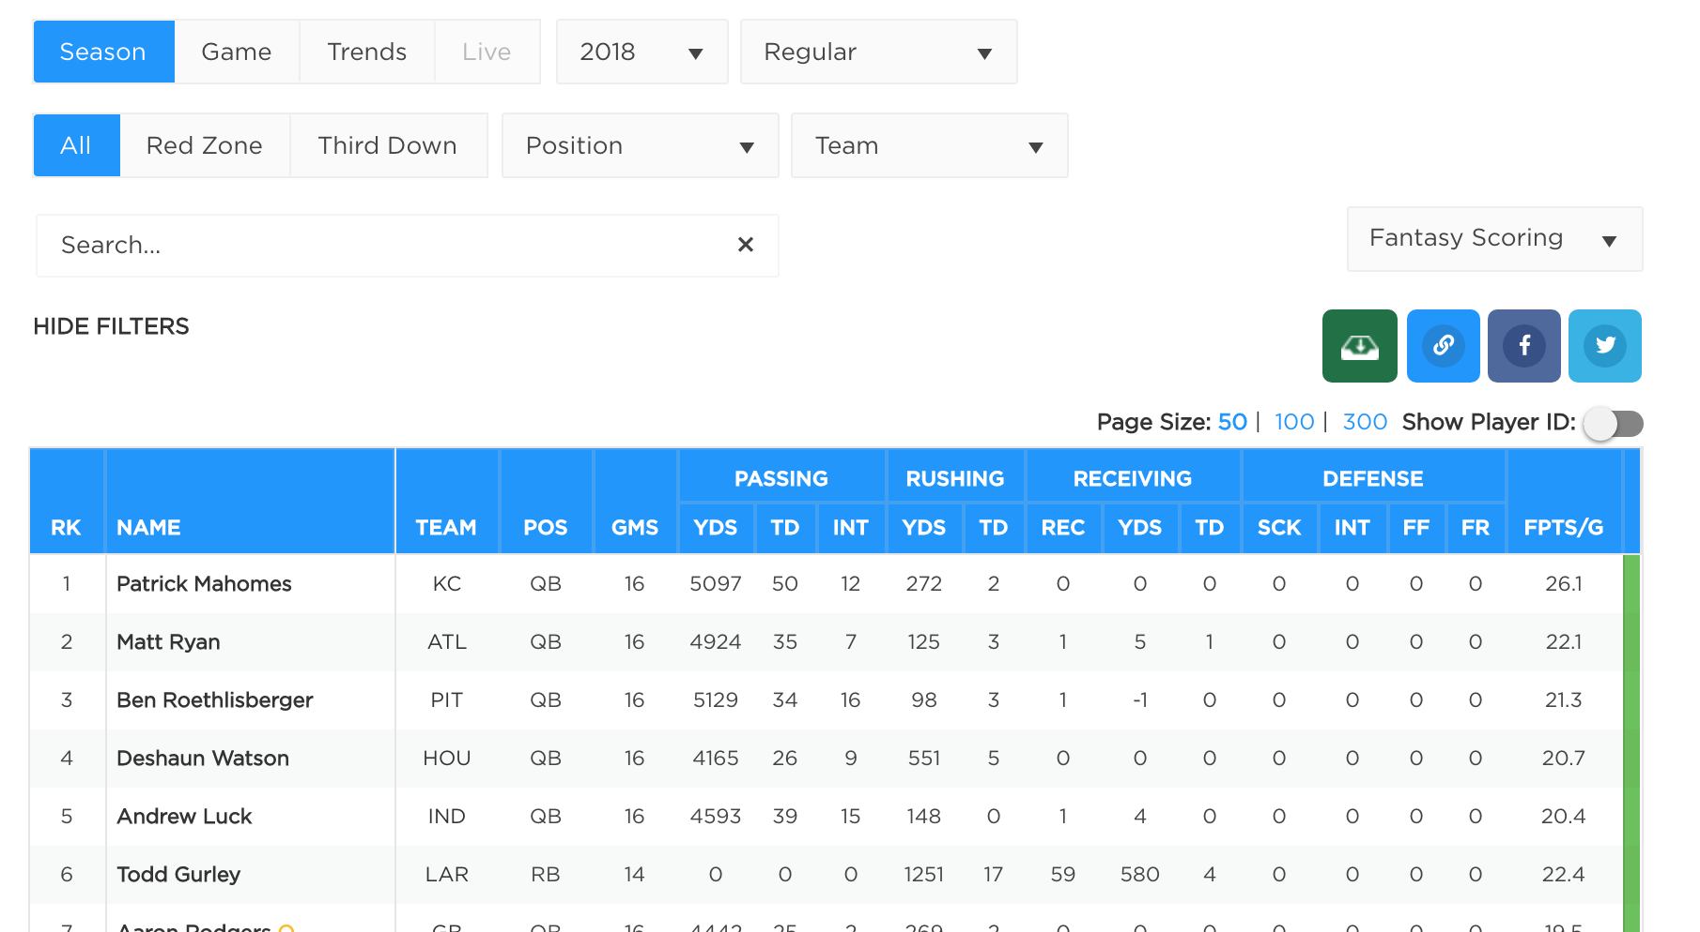
Player Statistics

Slide 3
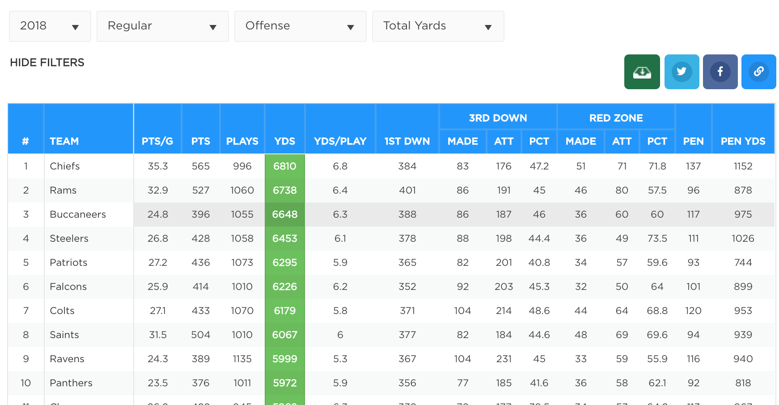
Team Statistics

Slide 4
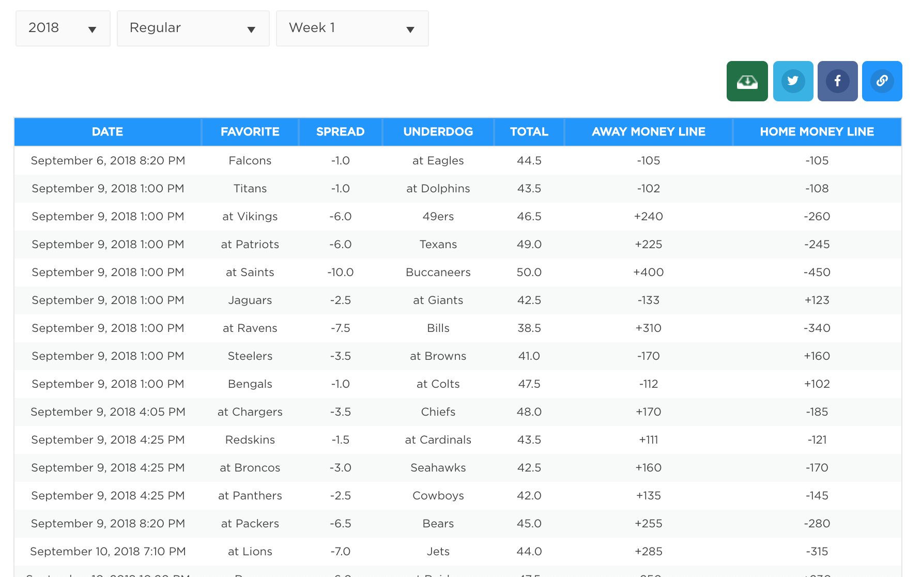
Team odds

